Slide 1
CLEAN ROOM MONITORING SYSTEM
SECOND REVISION

Slide 2
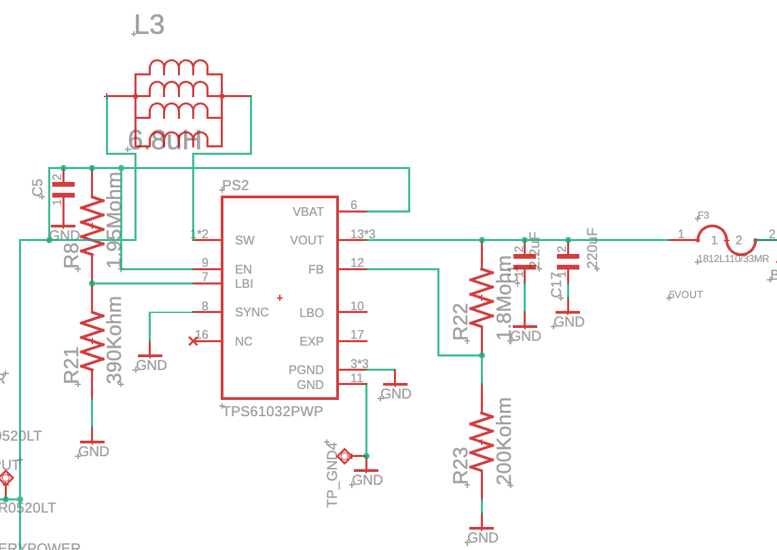
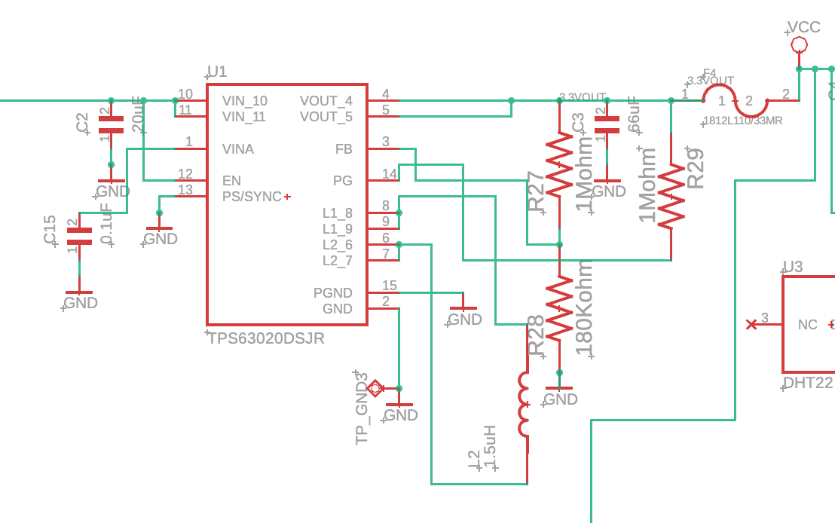
POWER
Booster, output 5V
Main parts in system.
Power goes to sensors + components
Both accepts voltage range of:
1.8V - 5.5V.
Buck-Boost, output 3.3 V
Output => determined by the feedback resistors
R3 = R4(Vout/1 - Vfb), Vfb = 0.5V

Slide 3
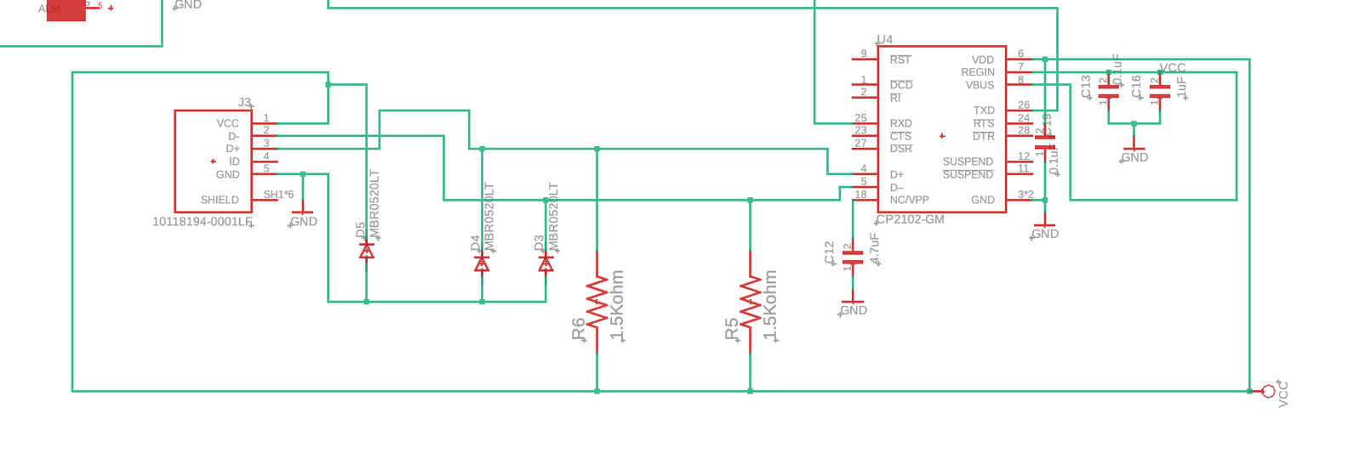
CANNOT UPLOAD CODE → PORT NOT SHOWING
POSSIBLE ISSUES:
CABLE → X
DRIVERS INSTALLATION → X
ADDITIONAL LIBRARIES → X
USB CONNECTION
Previous schematic

Slide 4
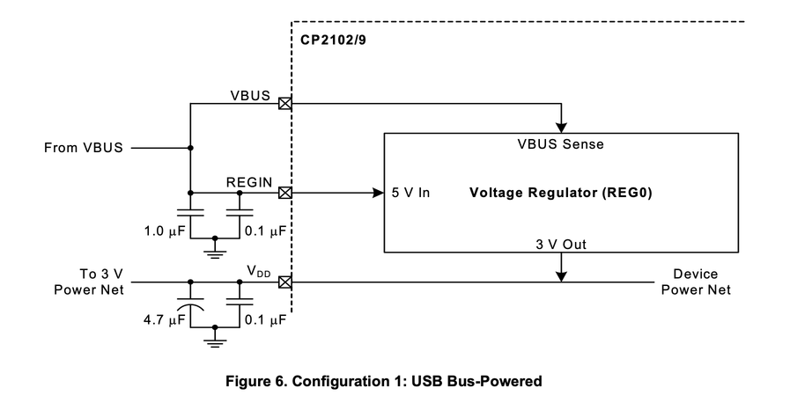
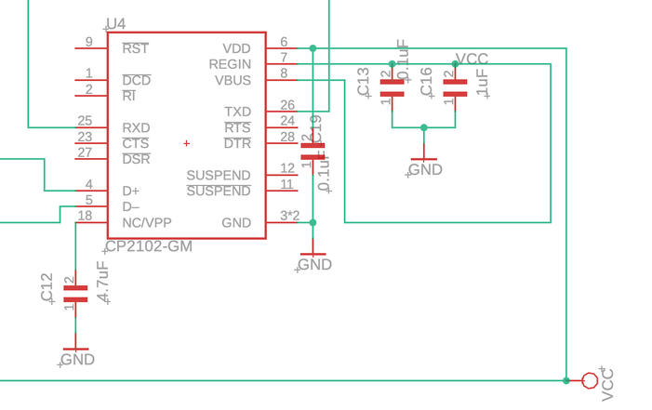
retrieved from:
https://www.silabs.com/documents/public/data-sheets/CP2102-9.pdf
CP2102-GM
Data sheet
Previous schematic
Problem:
USB is only for uploading code, not supplying power

Slide 5
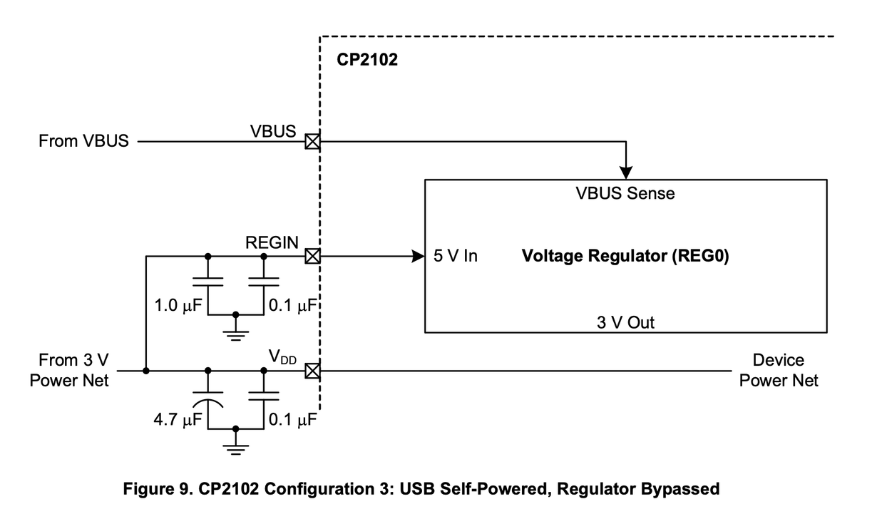
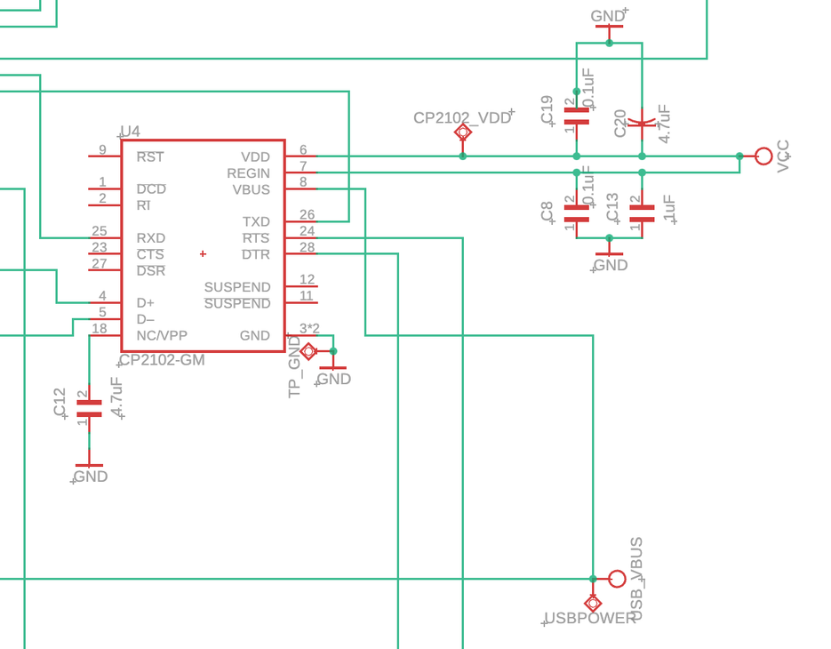
retrieved from:
https://www.silabs.com/documents/public/data-sheets/CP2102-9.pdf
Data sheet
Current schematic
Fix:
A different USB_VBUS line,
self-powered system.

Slide 6
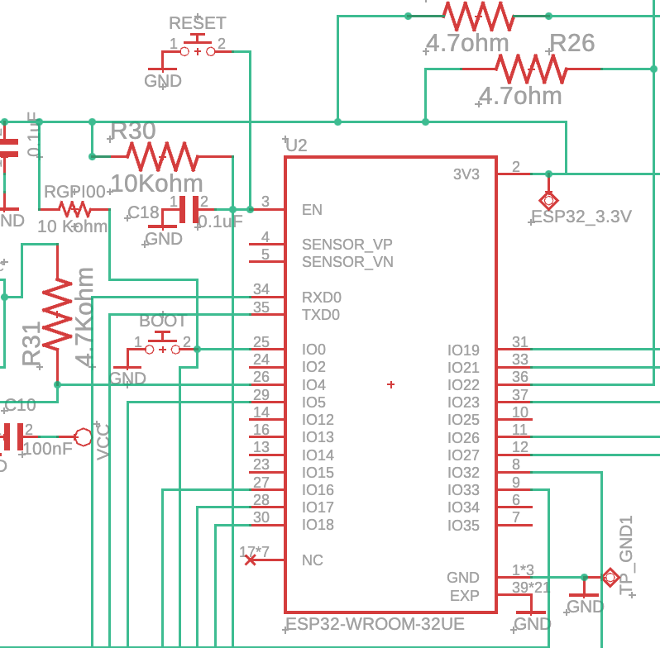
BOOT + RESET
Code Upload Problem?
Manually force ESP32 to enter bootloader mode to successfully upload code
How?
Click Upload on Arduino
Wait until you see:
Connecting...
Perform the sequence:
Hold BOOT
Press and release RESET
Release BOOT when you see “writing...”

Slide 7
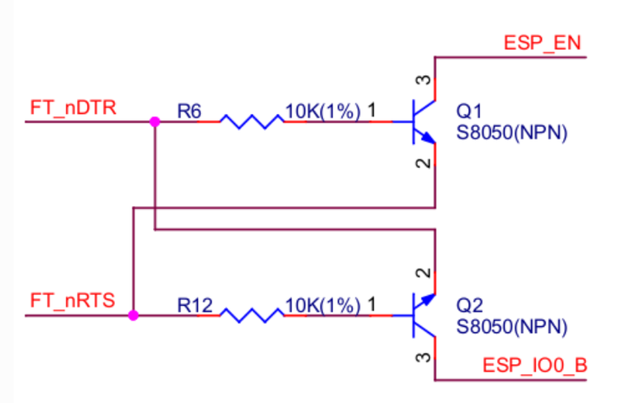
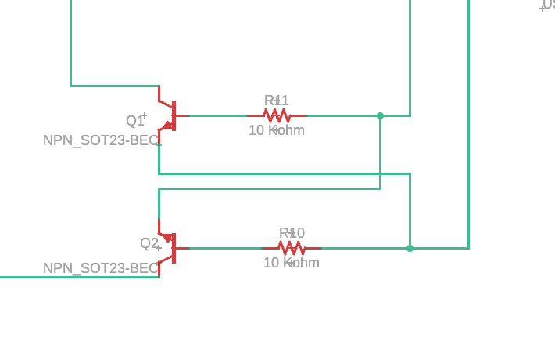
AUTO
PROGRAMMING
For all ESP modules, the reference image is recommended to enter boot loader mode.
Eliminates the need to manually press the BOOT and RESET buttons every time you upload code.
EN
DTR
RTS
retrieved from:
https://docs.espressif.com/projects/esp-iot-solution/en/latest/hw-reference/ESP-Prog_guide.html
IO0

Slide 8
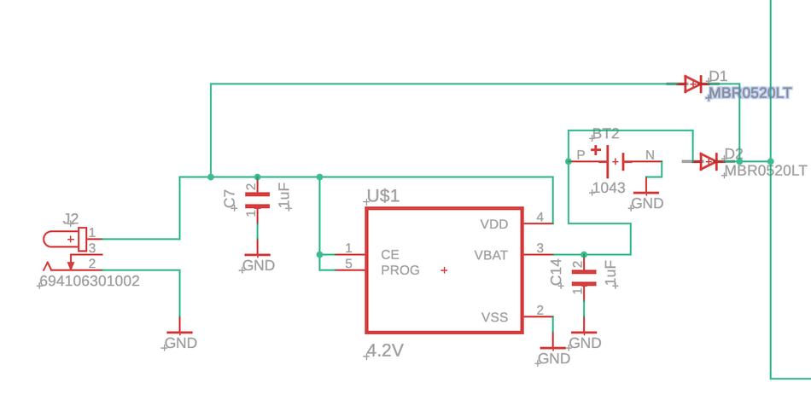
POWER SUPPLY
Schotky diodes determine the voltage through the intersection.
Higher voltage will pass.
DC JACK
BATTERY
Direct ~5V supplied to system
Initial stage and fully charged stage: still supplies voltage
Battery stops discharging at 3.0V to protect cell
Charges while DC is connected.
Supplies power once DC is disconnected, reliable in power outages.
3.0V - 4.2V discharge
Power Supply Architecture

Slide 9
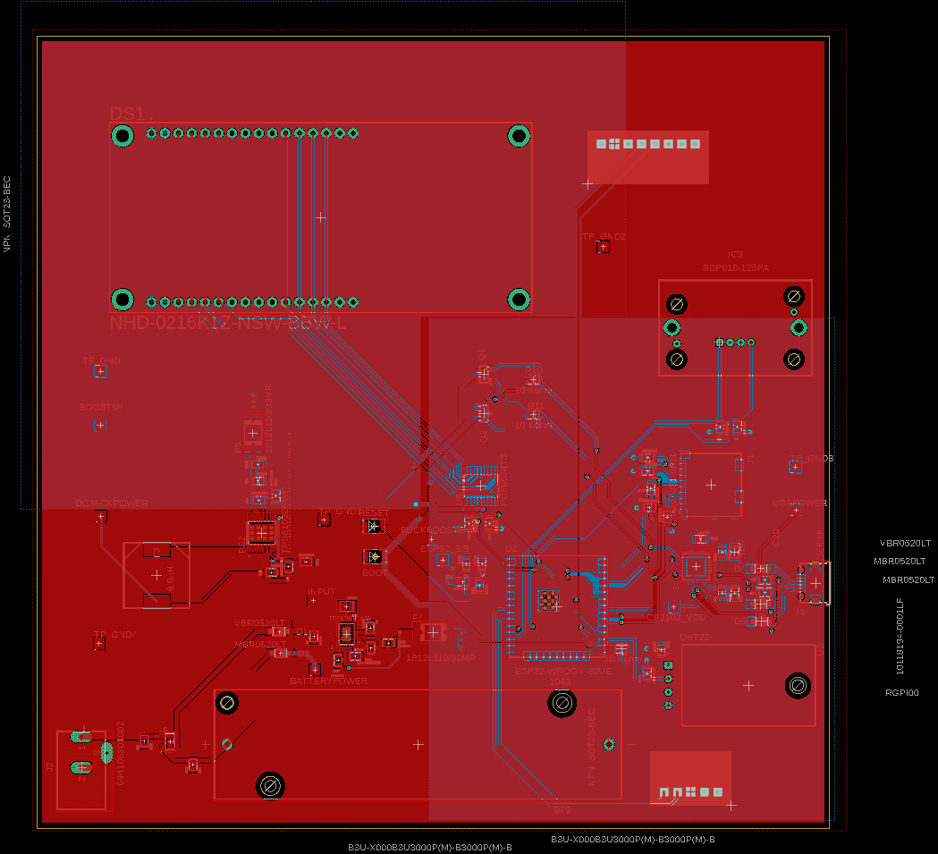
PCB BOARD
TEST PADS
Reset and Boot Buttons
Auto Programming
Alternative Wirings

Slide 10
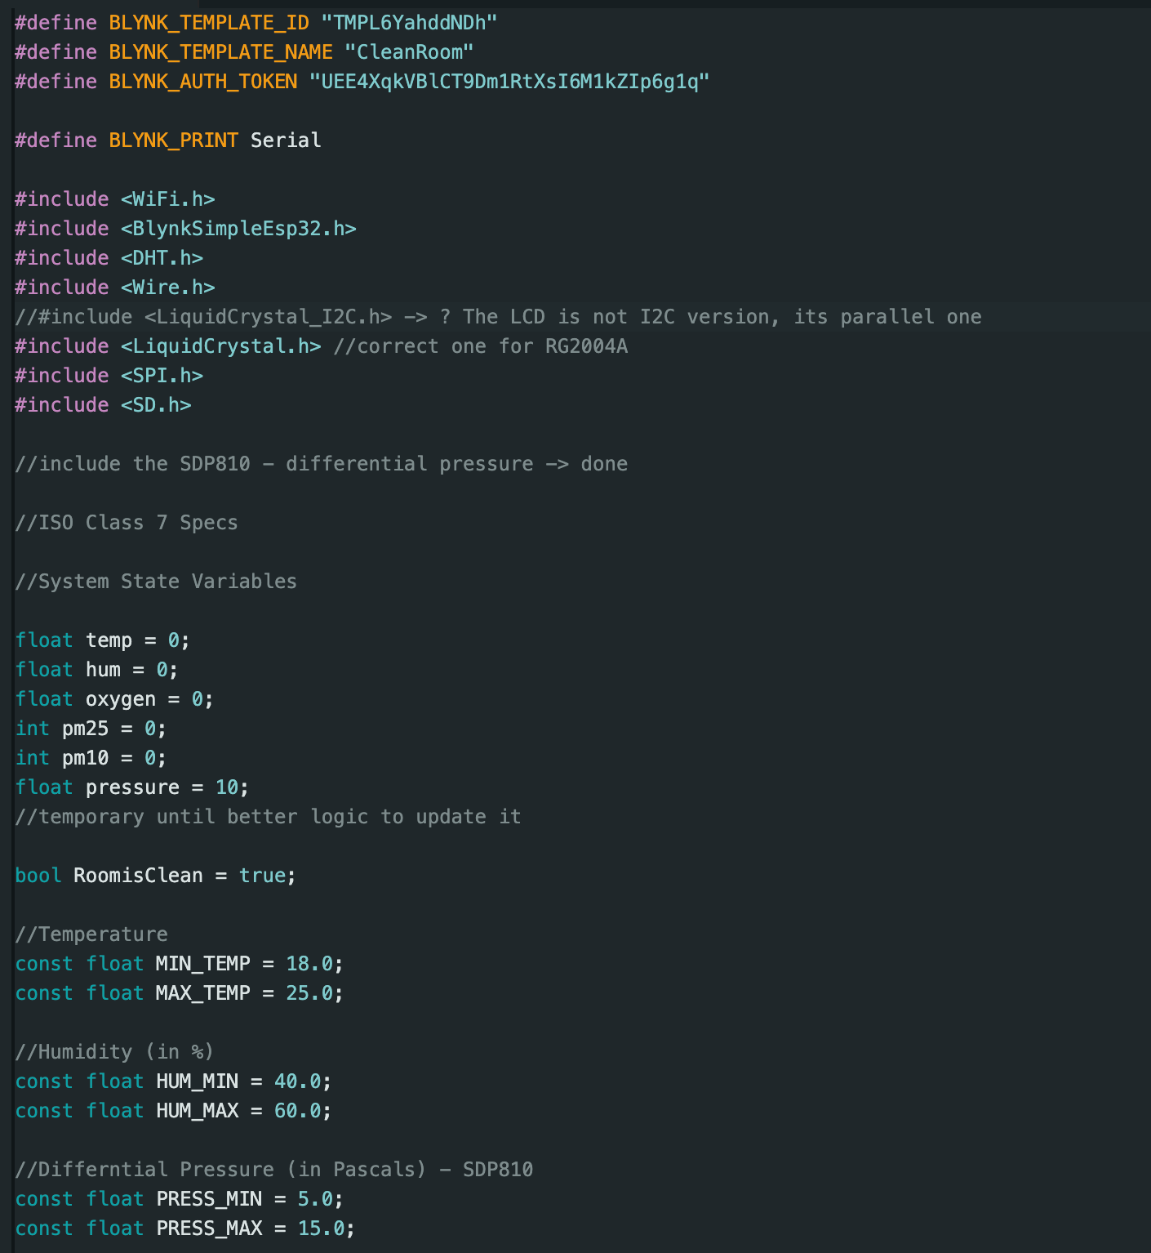
CODE + BLYNK
CLEANED
REMOTE NOTIFICATION ENABLED WITH BLYNK.IO
DEBUGGED
IMPROVED
NEXT PAGE
Extract of Arduino code

Slide 12
FURTHE R STEPS
CHECK HARDWARE
UPLOAD CODE, RUN IT
TEST SENSOR READINGS
ENCLOSURE DESIGN FOR COMPONENTS

